Slide 1
CSE 551 - Paper presentation
“Measuring smart grid resilience: Methods, challenges and opportunities”
By Group 11
Mandar Laxmikant Mahajan (SBU ID: 113276053)
Akanksha Kale (SBU ID: 113788594)
Akhila Juturu (SBU ID: 114777498)
Notes:
Hello, I’m Mandar. This is a video for CSE 551’s paper presentation. Today, we, members of group 11 will be presenting a paper titled “Measuring smart grid resilience: Methods, challenges and opportunities”

Slide 2
Evolution of power grid
Power grid is a critical infrastructure responsible for providing uninterrupted power supply
Technology advancements combined with research efforts have brought forth the evolution towards a smart grid
Notes:
The paper starts off by giving an current landscape of power grids, smart grids and factors affecting their performance.
So, what is a power grid?
The power grid is a critical infrastructure responsible for providing uninterrupted electric power to a range of residential and commercial consumers while meeting quality standards under constantly fluctuating operating conditions. Rapid advancements in sensing, computing and communications along with extensive research efforts aimed at improving the operation of the grid have provided the impetus to evolve towards a smart grid

Slide 3
Smart grid features
Load forecasting
Integration of renewable energy sources
Dynamic pricing
Demand response
Reduction in environmental footprint
Monitoring and controlling a geographically distributed cyber-physical system
Notes:
This evolution involves multiple facets including:
Integration of renewable energy sources, such as solar and wind power
Load forecasting, which we learnt and implemented in the first assignment
Dynamic pricing
Demand response
Reduction in environmental footprint
The operation of such a smart grid employing multiple novel technologies involves monitoring and controlling a geographically distributed cyber-physical system in a stochastic environment that consists of millions of components “owned, operated and regulated by thousands of different entities”
This presents unique technological as well as organisational challenges in operating and maintaining proper functioning of the grid, even under nominal conditions

Slide 4
Smart grid capabilities
A smart grid should:
be able to operate reliably under prescribed operating conditions
be robust to random fluctuations in such conditions
efficiently and swiftly recover from adversities and resume normal operation
Notes:
Smart grid is should be able to operate reliably under prescribed operating conditions and be robust to random fluctuations in such conditions. However, in addition to manageable random fluctuations encountered during everyday operations, a considerable number of extreme events also might occur. This includes natural calamities such as cyclones, hurricanes, earthquakes, etc., as well as adversarial attacks by human agents. Smart grid should able to able to recover from such adversities in a swift and efficient manner.

Slide 5
Resilience
Resilience is a property of systems that describes their response to, and recovery from extreme events
For the study of resilience in smart grids, research is being conducted in two different themes:
Qualitative approach | Quantitative approach
Development of qualitative frameworks for studying the resilience of the grid and identifying potential policies for improving the resilience | Developing metrics that can be used to quantify the resilience of the grid
Notes:
Resilience is a property of systems that describes their response to, and recovery from extreme events. This property is not unique to smart grid study, but has been widely studied in the fields of psychology, ecology and engineering.
For the study of resilience in smart grids, research is being conducted in two different themes:
The first approach involves development of qualitative frameworks for studying the resilience of the grid and identifying potential policies for improving the resilience. The second approach focuses on developing metrics that can be used to quantify the resilience of the grid. These metrics help assess grid architectures and improve response to adverse situations.

Slide 6
Reliability vs Robustness vs Resilience
Reliability
ability of the system to function properly under normal/prescribed operating conditions
Robustness
ability to withstand fluctuations in operating conditions and adverse situations while maintaining proper functionality
Resilience
ability to swiftly and efficiently recover from an adverse situation - one that has already resulted
Notes:
The authors continue on the topic of resilience by first differentiating resilience from related and easily confused properties of robustness and reliability.
Reliability refers to the ability of the system to function properly under normal/prescribed operating conditions.
Robustness refers to the ability to withstand fluctuations in operating conditions and adverse situations while maintaining proper functionality.
Resilience of a system on the other hand, describes its ability to swiftly and efficiently recover from an adverse situation - one that has already resulted in deterioration in the system’s performance - and resume normal operation.
The authors discuss that while systems are typically designed to be robust to a wide range of conditions, it is economically not feasible to study all possible scenarios while designing a system. In other words, it is not feasible to build a system that is entirely and exhaustively robust to varying extreme conditions, however, a system should be resilient to such changes.

Slide 7
Resilience of engineered systems
Figure of Merit (FOM):
A quantity that is representative of the functional capabilities of the system
FOM represents the functionality of a system in terms of the quantity and quality of the services delivered by the system
Notes:
Next, we look at resilience of engineered systems.
In order to develop a metric quantifying the resilience of a system, it is necessary to define a quantity that is representative of the functional capabilities of the system. This quantity can vary across systems, and is referred to in a common framework as the Figure of Merit (FOM).
FOM represents the functionality of a system in terms of the quantity and quality of the services delivered by the system.

Slide 8
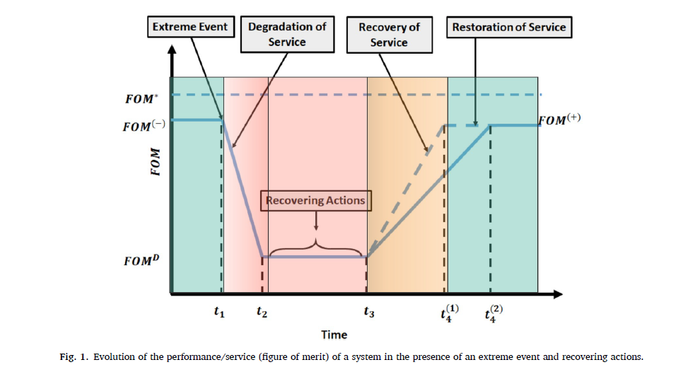
Notes:
The authors present how the FOM of a system evolves when an extreme event occurs. Based on this, they then propose metrics to measure resilience.
The system initially operates at a level of service denoted as FOM- prior to the occurrence of an extreme event, which can be less than a desired value of say, FOM*.
The extreme event occurs at time t1, after which the performance of the system degrades severely, and the FOM settles to a value of FOM-D at time t2.
Then, the system performs a set of recovering actions at time t2, after which the performance improves and settles at FOM+.
In the diagram, we see two trajectories of recovery of the system. This could be because of different recovery mechanisms, or different capabilities of the system.
In the first trajectory, the system recovers at time t41, and in the second trajectory, the system takes longer to recover and recovers at a time t42.
This suggests that the first strategy is more resilient to extreme events than the second.

Slide 9




Resilience metrics
 | Straightforward resilience metric
 | Bruneau et al.: Loss incurred due to extreme event
 | Rose: Direct Static Economic Resilience (DSER)
Notes:
Based on the scenario described, resilience metrics have been proposed.
A straightforward resilience metric is R = 1/(t4-t1). It is inversely proportional to the time-to-return, which is (t4 - t1)
Bruneau et. al proposed a metric which quantifies the amount of loss incurred by the system due to an extreme event. It is calculated as an integral of the deviation from the desired FOM. FOM(t) is a function of FOM wrt time.
Rose proposed another metric, which is called Direct Static Economic Resilience (DSER), where percent delta Y represents the percentage change in the direct output. Prior to the event, output was FOM- and then it degraded to FOM-D, so we have difference over the original amount.

Slide 10



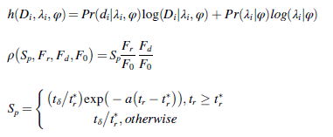
Resilience metrics (contd.)
 | Pant et al.
 | Dessavre et al.: Resilience after ‘n’ events
 | Resilience as a stochastic quantity
Notes:
The previous metrics considered resilience of a system as a static quantity. However, it is not always the case that resilience of a system itself does not vary depending on the severity of the event. The authors also present previous studies that measure resilience as a function of time.
For example, Pant. et. al propose a metric of resilience of a system with respect to an event e occurring at time t1 as a function of time tr.
Dessavre et al proposed a metric that quantifies the resilience of a system to a set of n events. Here, R is the resilience which is a function of time, a figure of merit and the stress induced by the events.
In addition to static, dynamic and composite measures, resilience has also been quantified in the literature as a stochastic quantity.
Here, the quantity h represents the entropy of the probability distribution of an event Di conditioned on the distribution of the parameter λi expressed in terms of φ (psi).
(rho - i) represents the resilience factor as a function of speed recovery factor (Sp), the performance of new steady state (Fr), disrupted state (Fd) and original steady state (F0).
The entropy and the resilience factor can be expressed as probability of di given lamda i, psi times log of Di given lambda i, psi plus probability of lambda i given psi log lambda i given psi
In the equation for Sp,
t delta represents the slack time,
t * r represents time to final recovery,,
Tr represents the time to complete initial recovery actions
And A is the parameter controlling the decay of resilience.
In this way, the authors have discussed several metrics for general engineered systems.
Next, Akanksha will present resilience and associated metrics in smart grids.

Slide 11
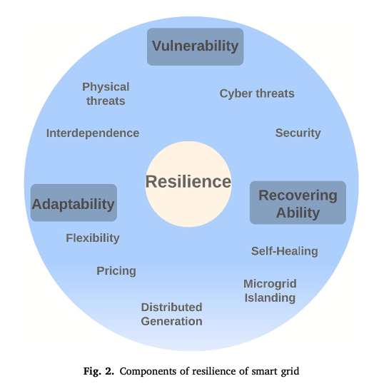
Constituent Properties of Resilient Smart Grids
Notes:
A Smart grid is geographically distributed system with continuous as well as discrete operating components
Properties such as vulnerability, self-healing and recovering ability, along with several others such as availability and logistics of components to be replaced, constitute the resilience of the smart grid
The shown figure represents these properties and the factors influencing these components. Let us quickly glance through them.
Vulnerability : inability to withstand adverse events
rapid development and adoption of smart grid technologies such as dynamic pricing and microgrids increase the randomness in the grid’s operations and make it more prone to instabilities and failures
extreme environmental conditions also result in an inevitable disruption of services that the system is required to recover from in an agile and efficient manner.
introduction of a communication infrastructure on top of the physical grid , exposing the grid to cyber attacks
Flexibility / Adaptability : is a property that allows it to better react to adverse conditions.
appliance-specific scheduling and microgrid islanding result in better response of the grid to dynamically evolving scenarios. This property can further contribute towards limiting the impact of the event and/or improve recovery time of the grid.
self healing / Recoverability: certain functionalities are automatically restored by a correction, or reconfiguration of the components
Ex: microgrid islanding : allowing independent operation of different regions till, say, a connecting line is replaced

Slide 12
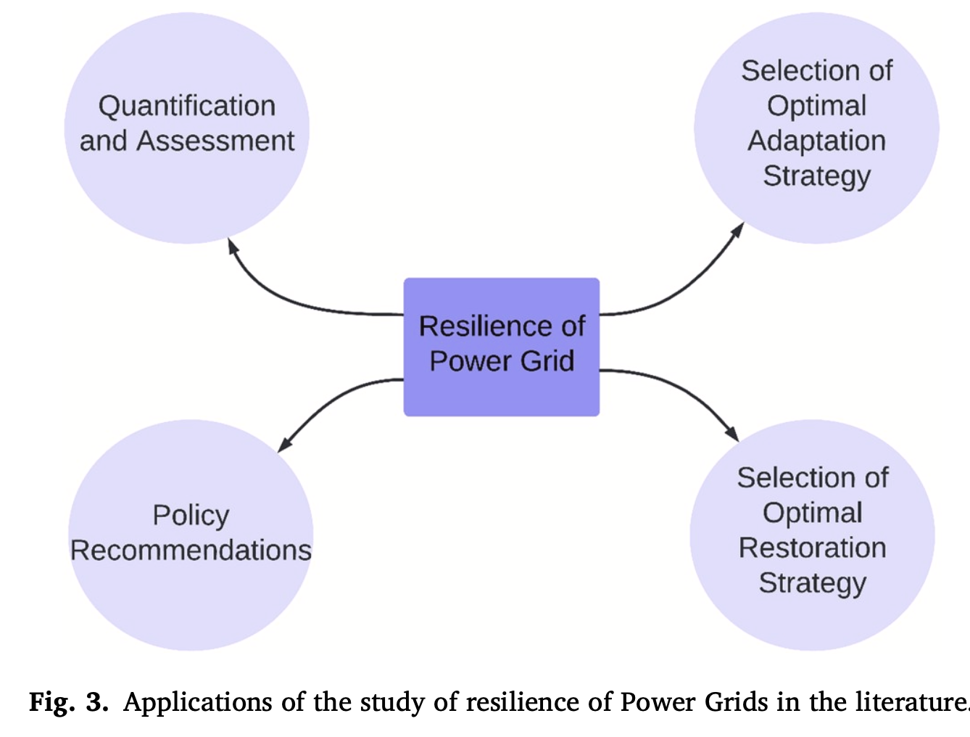
Applications of Study of Resilience
Notes:
The interactions between the factors and components is complex and hence there is a need to analyze their interactions systematically.
Such a systematic study of resilience to disruptive events has several implications on the efficient design and smooth operation of the smart grid.. A systematic analysis built on a holistic framework can offer tools for qualitative and quantitative assessment of smart grid resilience. Such an analysis can uncover approaches to identify candidate adaptation as well as restoration strategies and select those that optimise both the objectives, while accounting for (economic and societal) feasibility of different strategies. For example, the role of distributed power generation on resilience of the grid has been studied in the literature from the perspective of designing resilient grids.
A robust optimisation-based strategy to design distributions grids that are resilient to natural disasters such as hurricanes. It is formulated as a two-stage robust optimisation problem to coordinate system hardening and resource allocation in distributed generation so as to minimise system damage. The use of distributed generation to power multiple microgrids can also be done in real-time operations to restore critical loads after an extreme event.
There have been formulation of a mixed integer linear programming problem and optimise the restoration of critical loads while satisfying operational restrictions on the grid.
A game theory-based analysis and control of the behaviour of distributed microgrids with renewable generation. The authors formulate a non-cooperative game between microgrids and identify the Nash equilibrium to characterise the solu tions to renewable power generation in the microgrids.
We believe that these Insights derived from such studies can help identify gaps between the expected (infra- structural and organisational) capabilities and reality, which can be addressed via policy recommendations, roadmaps and design for resilience.

Slide 13
Qualitative Measures
Identifying and defining different components of resilience and developing frameworks that enable a systematic analysis of the property.
Interdisciplinary Approach
Cyber Physical Resilience
Load Reduction
Infrastructure and Community
Vulnerability and Adaptability
Temporal and Spatial Aspects
Operation and Strategy
Notes:
Let us dive into it in the next section which reviews different qualitative and quantitative approaches adopted to study the resilience of the smart grid.
A qualitative analysis of resilience of the grid involves identifying and defining different components of resilience and developing frameworks that enable a systematic analysis of the property.
This paper only projects measures used in different literature but talks nothing about anything about a preferred approach in certain situations.
Below are different methods and approaches used by different researchers.
Inter-disciplinary approach - different methods of measuring resilience in ecology, psychology, risk management and energy security. The measurement of adaptive capacity and concepts of diversity, redundancy, system structure and monitoring as common themes and factors employed across disciplines is used to measure the resilience of a system.
Cyber-physical resilience of power systems - its ability to maintain continuous electricity flow given a certain load prioritisation scheme such that a resilient system can alter its struc- ture, loads and resources in a agile manner. The authors describe the physical, cyber and cyber-physical vulnerabilities of power systems and discuss the different challenges in designing a resilient power grid.
reduction in load- analysed the coordination of multiple microgrids with a hierarchical optimisation model and studied the performance of the system in terms of the extent of reduction in load.
conceptual framework that incorporated the temporal and spatial aspects as well as scales of the problem of quan- tifying resilience in the face of an energy crisis. The authors defined the regional energy resilience and proposed merging value-based and fact-based methods of assessing regional energy resilience for deriving policy recommendations. The factual and value aspects of regional en- ergy resilience were then applied to data collected in Austria [86] with respect to the temporal and spatial aspects of energy crisis
organising different metrics of resilience to guide both operational and strategic decisions. The pro- posed framework included inputs, capacities, capabilities, performance and outcomes as five classes into which different metrics of resilience were categorised. The proposed framework also allowed categorising metrics based on the resolution/scale of influence as facility/system level, system/region level and region/nation leve

Slide 14
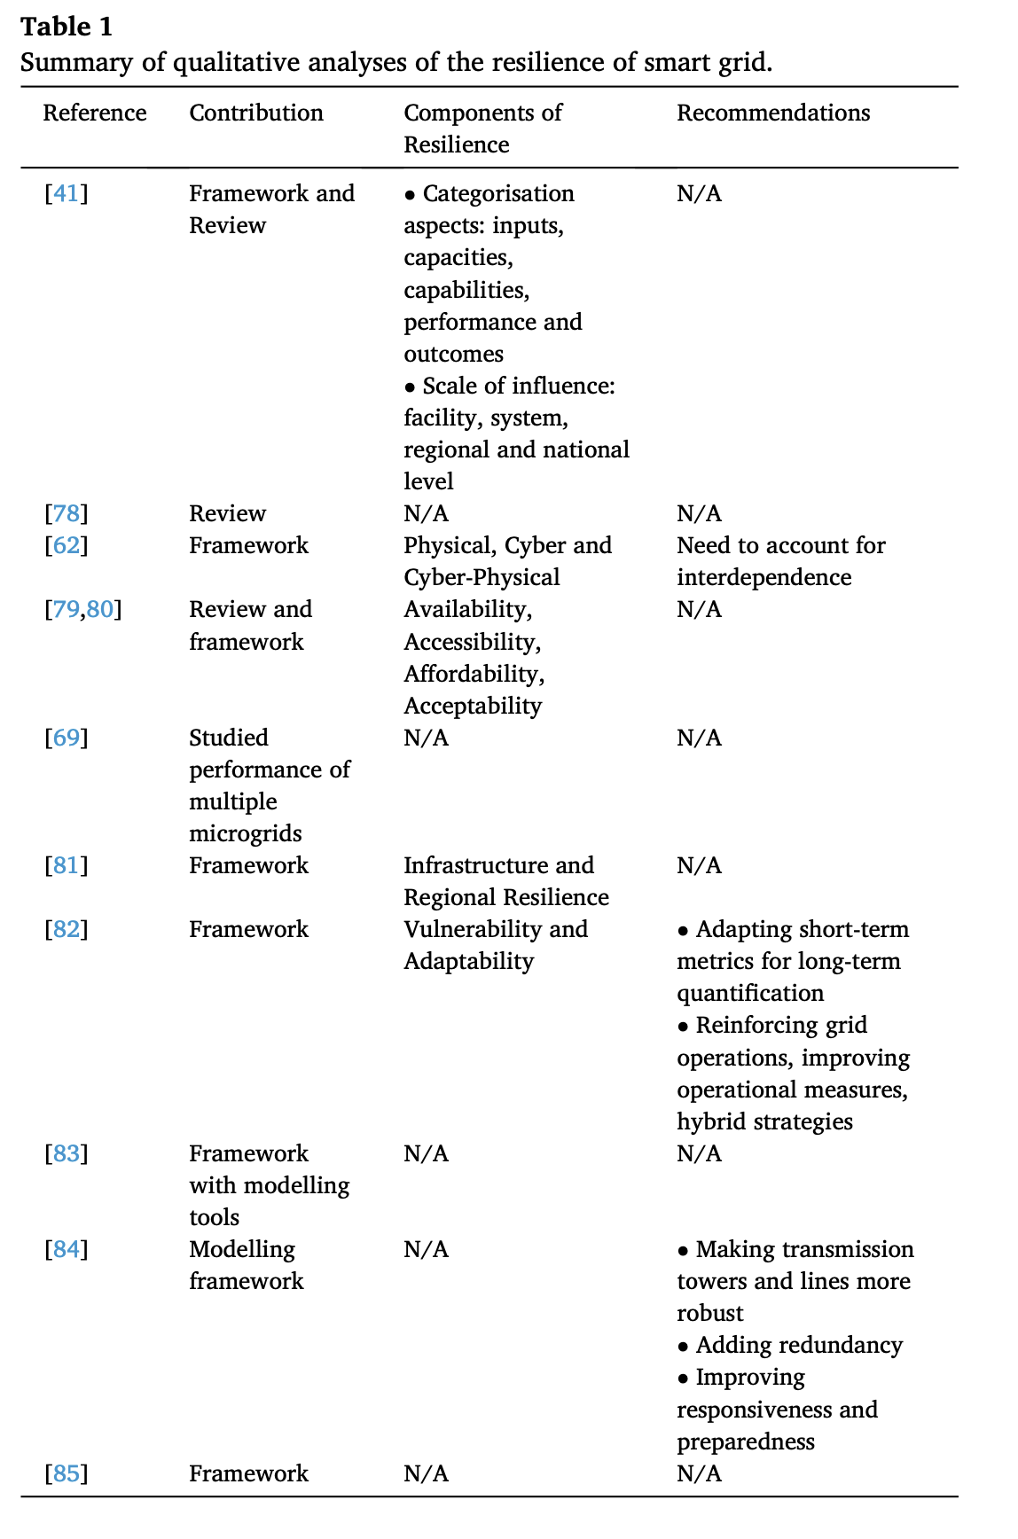
Notes:
Below are different methods and approaches used by different researchers.
Interdisciplinary approach - different methods of measuring resilience in ecology, psychology, risk management and energy security. The measurement of adaptive capacity and concepts of diversity, redundancy, system structure and monitoring as common themes and factors employed across disciplines is used to measure the resilience of a system.
Cyber-physical resilience of power systems - its ability to maintain continuous electricity flow given a certain load prioritisation scheme such that a resilient system can alter its struc- ture, loads and resources in a agile manner. The authors describe the physical, cyber and cyber-physical vulnerabilities of power systems and discuss the different challenges in designing a resilient power grid.
reduction in load- analysed the coordination of multiple microgrids with a hierarchical optimisation model and studied the performance of the system in terms of the extent of reduction in load.
infrastructure resilience and community/regional resilience: measuring resilience using a systems approach and identified qualitative methods for measuring critical infrastructure resilience and community/regional resilience.
conceptual framework that incorporated the temporal and spatial aspects as well as scales of the problem of quan- tifying resilience in the face of an energy crisis. The authors defined the regional energy resilience and proposed merging value-based and fact-based methods of assessing regional energy resilience for deriving policy recommendations. The factual and value aspects of regional en- ergy resilience were then applied to data collected in Austria [86] with respect to the temporal and spatial aspects of energy crisis
organising different metrics of resilience to guide both operational and strategic decisions. The pro- posed framework included inputs, capacities, capabilities, performance and outcomes as five classes into which different metrics of resilience were categorised. The proposed framework also allowed categorising metrics based on the resolution/scale of influence as facility/system level, system/region level and region/nation leve

Slide 15
Quantitative Measures
Quantitative analyses of the resilience of smart grids have aimed at developing metrics that quantify the resilience while accounting for aspects such as temporal and spatial dependence as well as uncertainty (due to internal and external factors) in system operation
-FOM(Figure of Merit) represents the functionality of a system in terms of the quantity and quality of the services delivered by the system.
Notes:
These measures are based around FOM that we studied earlier in the paper with the use of consistent notations.

Slide 16
Dynamic Vs Static Measures
-dynamic metrics have been studied in the literature, that quantify resilience as a function of time - during loss and recovery of performance.
-dynamic metrics are always calculated as a function of time, and as a result may vary across realisations of the same event introduced for the same system.
The static measures of resilience represent a single metric of the systems resilience and do not account for differences in different realisations of the same scenario.
Notes:
However, since both approaches quantify the same underlying property, static metrics can be considered as being the ensemble averages of dynamic metrics calculated till complete recovery, for the same events facing the system. The choice of the metric therefore depends on the amount of information available to the user, and the end- use of the metric. For example, static metrics are useful if the user in- tends to incorporate resilience in designing a system. On other hand, if the user expects to have temporal data of an existing system corre- sponding to the events and wishes to improve the recovery of the system in real-time by incorporating such data, then dynamic measures are likely to provide a more accurate measurement of resilience than static measures.

Slide 17
Static Measures

Slide 18

Metric 1
td - time at which degradation of the system begins,
tpr - time when microgrid has completely restored to normal operations.
Three stage framework for resilience assessment that includes :
Data entry
Restoration strategies
Estimation of degradation
Notes:
td and tpr represent the times at which degradation of the system begins, and when the microgrid has completely restored to normal operations, respectively.
The authors also proposed a three stage framework for resilience assessment that includes (i) data entry; (ii) component-based degradation model of a microgrid for estimation of the extent of degradation, and (iii) restoration strategies of microgrid.
The authors studied the impact of the restoration strategy, component strength and severity of the extreme event on the resilience of the microgrid.

Slide 19
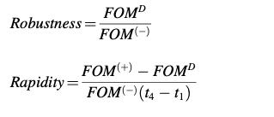
Metric 2 : Power and water systems
Resourcefulness
Rapidity
Recovery
Robustness
Notes:
Resilience calculation has also been composed of multiple components such as resourcefulness and recovery, which are captured with composite metrics. In addition, the resilience of smart grid coupled with other critical infrastructures has also been studied with composite metrics. It was also identified as robustness and rapidity as two important dimensions that constitute resilience of integrated power and water systems
FOM now represents the combined figure of merit of water and power systems.

Slide 20


Metric 3 : Composite Measures
Metric 4: Composite Measures
Identify the best strategy to increase resilience with a combination of genetic algorithms and an index-maximisation problem.
Minimise the time required to restore access to power and water infrastructures after a disaster
Resourcefulness
Recovery
Robustness
Notes:
Here the resilience of power and water distribution system for proposing improvement in planning under hur-
ricanes is defined using a component-based description of resilience
-where each of the terms is normalised to lie in the range [0,1]
-Rmin represents the minimum value of the measurement of performance MoP,
-t0 represents the time of occurrence of the event, tER and tFR represent the expected and actual time of recovery of performance and tmin represents the minimum time interval needed for improvement of performance of the system.
This index was employed with an aim to (i) minimise the time required to restore access to power and water infrastructures after a disaster, and (ii) identify the best strategy to increase resilience with a combination of genetic algorithms and an index-maximisation problem.
A different composite measure of resilience constituting of the robustness, resourcefulness and recovery of the grid in the face of adversities as:
where ei represents the weight of the ith component Vi. Each of the three components were further composed of different sub-components that were weighed in different proportions to obtain the corresponding Vi.

Slide 21
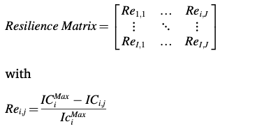
Resilience Matrix
Notes:
An energy system has several functional services it has to deliver and has multiple vulnera- bilities which can deteriorate its performance. Then the authors formulated the functional loss as a matrix that stores the loss incurred in each service by each event as a function of time resulting in a three dimensional loss matrix. This was then reduced to a two dimensional matrix that lists the monetary cost incurred by all the stakeholders in each event as a function of time, referred to as the consequence matrix. The resilience was then also developed as a matrix listing the resilience of (all functional capabilities of) the system to the jth event during the ith time period as [94]:
where ICMax and ICi;j represent the maximum (if all functional services are lost) incurred cost and actual incurred cost due to the jth event in
each scenario during the ith time period. The authors studied the resil- ience of a large office building in Boston with an integrated energy system [94] having six functionalities to ten disruptive events and identified resilience improvement measures from the resilience matrix.

Slide 22
Dynamic Measures

Slide 23


Metric 1 : With performance measure
Metric 2 : Stochastic | Space and time dependent
Notes:
Here, resilience was quantified via a performance measure pi(tp) as
where pi and pi represent the nominal value of the performance mea-
sure and the collapse threshold, respectively. The collapse threshold corresponds to the value from which the system cannot recover on its own. The above quantity describes the ratio of the actual system per- formance to the worst case performance.
In the above expression, m represents the number of disruptions, ω
represents the scenario and can be either f (failure) or o (outage), i
represents the index of a node, λ represents the expected number of disruptions at time τ due to a particular cause of disruption ω represents the duration of the disruption at the ith node at time τ caused due to the scenario represented by ω.
The second term therefore represents the expected percentage of recoveries at time t and the overall quantity represents the expected number of nodes in region Z at time t that are either in normal operation, or recover during an additional duration d0.
The authors used the approach to quantify the resilience of the power grid to Hurricane Ike using real life data, and identified dis- parities between large-scale failures caused by the hurricane and the recovery process.
Their study suggested the necessity of a more in-depth analysis of the system at component-level for identifying the vulnera- bilities of the system and for improving its resilience.

Slide 24
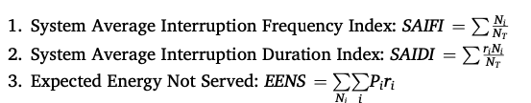
Performance Based Measures
Notes:
Where Ni and NT represent the number of times the ith customer experiences interruption in service and the total number of customers, respectively. ri Represents the duration of interruption experienced by the ith consumer. System Average RMS Frequency Index, SARFIx representing the frequency of voltage sags for which the magnitude of voltage was less than x% of the nominal value was used.
edge resilience trajectories as indicators of the resilience of the power grid have been considered
use of the energy intensity of a gross domestic product (GDP), defined as the ratio of the total primary energy supply to the GDP, which is a composite measure of the energy vulnerability of a country

Slide 25
Other Metrics
Studied of the resilience, tolerance and adaptability of energy systems and identified the resilience of the system as the mean time to recover from an event
A composite measure of resilience of the national power system composed of seven normalised indices.
Interaction between the system and the surrounding environment, especially the vegetation had a significant impact on the resilience of the system.
Combined methods of graph theory, percolation theory and analytical hierarchical processes and developed a composite measure of resilience of electric distribution systems with multiple microgrids.
use of defensive islanding in the grid to prevent cascading failures caused due to extreme weather conditions and assessed the resilience with the number of customers that were disconnected during the event.
Notes:
authors also identified that power outage durations were spatially dependent up to a certain distance from the outage location and it was therefore important to include a spatial outage model to better acquire the dynamics of the system

Slide 26
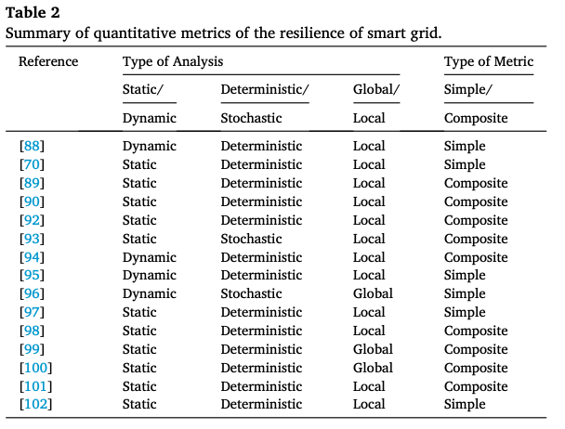
Comparison

Slide 27
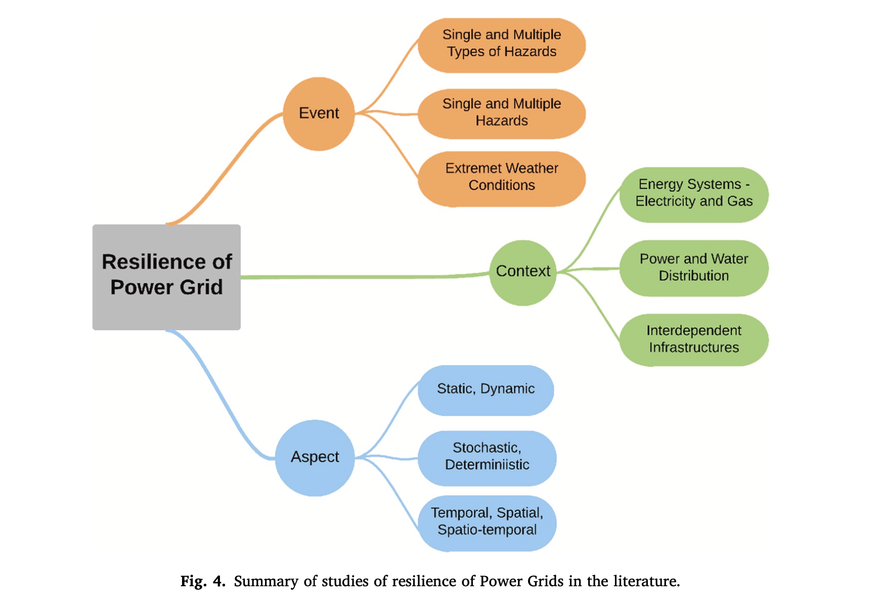
Notes:
Thus, to summarize Qualitative and Quantitative measures have been considered as a important aspect to implement the design of a resilient smart grid. A resilient smart grid can be defsigned with focus on specific Events, Aspects and Context. We looked components shown in the bubbles in the figure above. Now Akhila will present the next section. Thank you.

Slide 28





Challenges in smart grid resiliency analyses
1
Temporal and Spatial Scale of the System:
Developing a framework as well as a metric that accounts for the distributed dynamics of the geographically vast, yet largely connected system becomes extremely challenging.
The power grid is maintained and operated like any other industry, at different infrastructural scales ranging from operational unit to a nationwide service.
Developing a holistic framework that is suited to these levels involves large number of factors to be considered.
2
Organizational Aspect
3
Real Life implementation
Large levels of uncertainty in the measures were identified while implementing such indices towards quantifying the resilience of the grid.
Metrics developed in the literature such as the estimated time of recovery has been identified as being difficult to estimate from the data, owing to the non-stationary nature of failure dynamics in the system.
4
Estimation of Metrics
5
Chance of Cyber Attacks
A cyber layer exposes the grid to targeted attacks from remote locations, more so during extreme weather induced failures.
Notes:
Hello everyone, I’m Akhila Juturu. I will be talking about the underlying challenges, weaknesses, strengths and opportunities for innovation faced in smart grid resiliency analyses
This paper majorly focuses on the measures used in different literatures and it is not a system implementation. The challenges faced in smart grid resiliency analyses are

Slide 29
Desirable Properties of Resilience Metrics
1
It should incorporate the spatio-temporal variations in the grid. It should be able to account for the coupled or decoupled operations of facilities serving different geographical regions, as well as be dynamic in nature, evolving as the system recovers with time.
2
It should be goal-oriented, aimed at answering specific questions of interest at different organisational scales of the grid
3
It should be able to account for the uncertainty in the grid as well as the environment, but should not itself exhibit large variations in order to be reliably interpreted and acted upon.
4
It should be easy to calculate/estimate from data
5
It should be able to incorporate multiple modes of adversities acting possibly simultaneously on the grid.

Slide 30
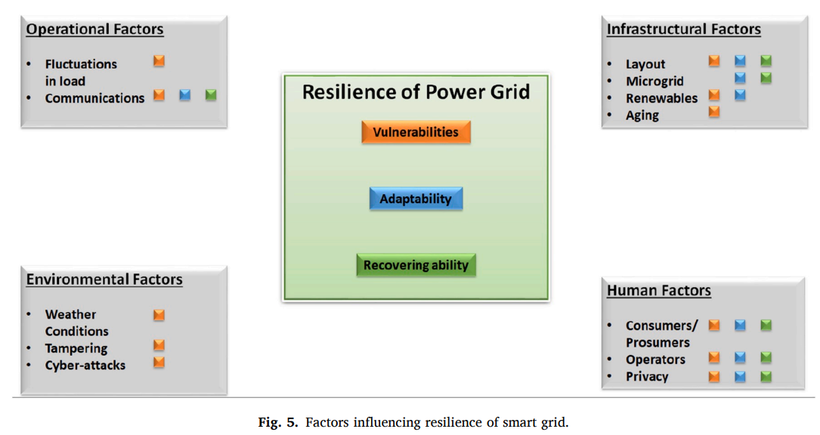
Opportunities for Innovation
Notes:
Next Let's look at opportunities for Innovation
There is a plethora of studies focused on the resilience of smart grids, ranging from the development of conceptual frameworks and quantitative metrics to case studies with policy recommendations and review articles.
The resilience of the power grid has popularly been identified in the literature as consisting of three distinct components - vulnerabilities, adaptability, and recovering ability.
These components are respectively shown in orange, blue, and green in the figure, and factors influencing each component are assigned pellets of corresponding colors.
This figure shows several of the technological and operational factors influencing the operation and resilience of the grid, broadly classified into four categories.
Operational factors include fluctuations in load, communications between different nodes, and smart grid technologies such as dynamic pricing and demand response schemes.
Infrastructural factors encompass all physical devices and the layout of the grid as a network of interconnected devices. This class of factors also includes technological advancements such as integration of renewables into the power grid and electric vehicles that increase
Human factors, include the involvement of consumers and prosumers in the grid operations and operators monitoring the operations at different facilities uncertainty in the grid operations
Environmental factors, on the other hand include external weather conditions and human activities such as tampering of devices and cyber-attacks.

Slide 31
Practical Aspects include:
Severity of event and extent of recovery
Multi-modal attacks and available information
Big data challenges relevant to resilience
Interdependent infrastructures and heterogeneous nodes
Notes:
In addition to the above factors, several practical aspects of a smart grid, especially related to the implementation and functioning of the grid are
Severity of event and extent of recovery
Multi-modal attacks and available information
Big data challenges relevant to resilience
Interdependent infrastructures and heterogeneous nodes

Slide 32

Severity of Event and Extent of Recovery
The same type of event occurring at different intensities can potentially have widely different impacts.
It is therefore important to incorporate the intensity of a type of adversarial event in order to completely understand the resilience of the grid.
To that end, a continuous-valued parameter α can be incorporated in the framework of analysis that quantifies the severity of an adversarial event.
It is also desirable from a practical standpoint to account for the extent of recovery of the grid.
Notes:
●Adversities such as extreme environmental conditions, unexpected equipment failure, and adversarial attacks typically exhibit different degrees of severity/intensity.
●These conditions can disrupt grid operations to varying degrees.
Before first point
Secondly
●The recovery of the grid under different severities of say cyber-attacks can potentially exhibit phase-transition-like behavior.
●It is therefore important to incorporate the intensity of a type of adversarial event in order to completely understand the resilience of the grid.

Slide 33

Multi-modal attacks and available information
The space of attacks on the smart grid now include cyber, physical and cyber-physical which can be made while the grid is recovering from another extreme event.
Several approaches were proposed to overcome this challenge like the use of blockchain technology, game theory etc. but majority were focused on failure prevention rather than improving response and recovery from failure.
The simultaneous presence of multimodal attacks has also not been studied in the literature.
A grid that has more information regarding different operating units and facilities is more likely to coordinate and recover faster than one that suffers from lack of such visibility.
Notes:
●The introduction of a cyber-layer that enhances grid visibility and situational awareness also leads to greater vulnerability.
Several approaches were proposed to overcome this challenge like the use of blockchain technology, game theory etc. but majority were focused on failure prevention rather than improving response and recovery from failure.
●Adversarial agents can now steal critical information related to grid operations and manipulate prices to generate revenue and destabilize the grid operations.
●It is therefore important to include multiple modes of attacks that can simultaneously work towards degrading the performance of the grid.
The simultaneous presence of multimodal attacks has also not been studied in the literature.
●Another major aspect associated with the cyber layer that has not been considered in the literature is the importance of information available to the agencies involved in grid recovery.

Slide 34

Big data challenges relevant to resilience
Large-scale collection of data from across the grid as well as external weather stations has enabled big data analytics that provide yet another promising approach towards studying and enhancing the system’s resilience.
A widespread use of platforms such as Hadoop and Spark should be explored and the proposed approaches validated with data.
It is also important to identify key components in the network that are important for recovery, study the impact of factors such as sampling frequency, noise and missing/tampered data on the recovery of the system.
Notes:
The cyber layer and communication infrastructure form a fundamental component of the smart grid which can be exploited for efficient recovery from extreme events. Large-scale collection of data from across the grid as well as external weather stations has enabled big data analytics that provide yet another promising approach towards studying and enhancing the system’s resilience.
It is also important to identify key components in the network that are important for recovery, study the impact of factors such as sampling frequency, noise and missing/tampered data on the recovery of the system.
In addition to the selection of nodes based on importance, the reliability of data especially during an adversarial condition plays a key role on the recovery of the grid.

Slide 35

Interdependent infrastructures and heterogeneous nodes
With the rapid development of communication technology and emergence of smart cities, the interdependence between infrastructures becomes severely accentuated.
A considerable amount of research effort has been devoted towards addressing the impact of this, however, a concrete mathematical framework that accounts for the heterogeneity of components is lacking.
Interdependence of infrastructures imparts heterogeneity to different loads connected to the grid, resulting in different levels of importance of loads in different aspects.
Notes:
With the rapid development of communication technology and emergence of smart cities, the interdependence between infrastructures like water distribution, transportation, healthcare systems becomes severely accentuated.
· For example, the introduction of electric vehicles and associated charging stations and lanes on the roads injects a considerable amount of uncertainty in the load of the power grid, as opposed to deterministically timed lighting loads.
· A considerable amount of research effort has been devoted towards addressing the impact of interdependence on the resilience of infrastructures.
· However, a concrete mathematical framework that accounts for the heterogeneity of components and different strengths of coupling between infrastructures that also studies the impact of other aspects of interdependence (such as cyber, geographic, and logical interdependence) is lacking.

Slide 36




Conclusion
The conceptualization, articulation, and measurement of the resilience of the power grid bears significant importance in a smooth transition to a more intelligent grid.
These topics have therefore received considerable attention in the literature with a range of assumptions, frameworks, and measures.
This article presented the findings of a systematic review related to measuring the resilience of the smart grid.
These approaches are important for better understanding resilience in terms of qualitative and quantitative formulations as well as the real-life measurement of resilience in the presence of noisy data in an uncertain, adversarial environment.
Notes:
To sum up the paper, it identified the qualitative frameworks proposed to analyze the resilience of a geographically vast, organizationally diverse, and technologically advancing cyber-physical system that is the smart grid.
· The conceptualization, articulation, and measurement of the resilience of the power grid bears significant importance in a smooth transition to a more intelligent grid.
· It also focused on Quantitative metrics devised to capture the temporal and spatial dependence of resilience, along with the stochastic nature of the environment.
· These topics have therefore received considerable attention in the literature with a range of assumptions, frameworks, and measures.
· The paper also highlighted Major challenges in addressing the resilience of the grid.
· These approaches, and possibly several others are important for better understanding resilience in terms of qualitative and quantitative formulations as well as the real-life measurement of resilience in the presence of noisy data in an uncertain, adversarial environment.

